Slide 1
Cyclistic bike-share
Presented by : Ankush kulkarni
Last Updated : 02-04-2022

Slide 2
Table of contents
Objectives
My Findings
Conclusion

Slide 3
Objective
To determine how Casual riders and Annual members use cyclistic bike differently. Using this our team will design a new marketing strategy to convert Casual riders into Annual members.

Slide 4
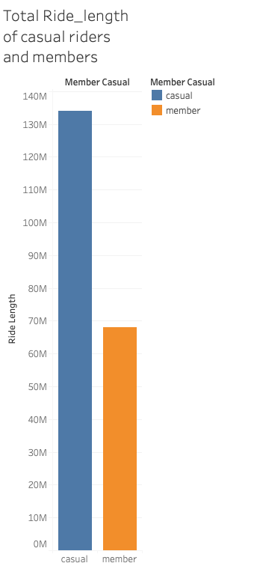
Total ride length
Casual riders travel almost double distance.
Members travel 50% less.

Slide 5
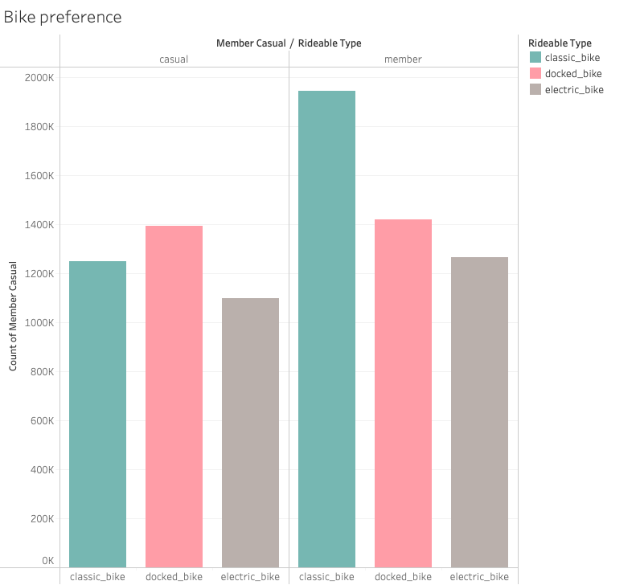
Bike preference
Casual riders travel most on docked_bike
Second preference is classic_bike

Slide 6
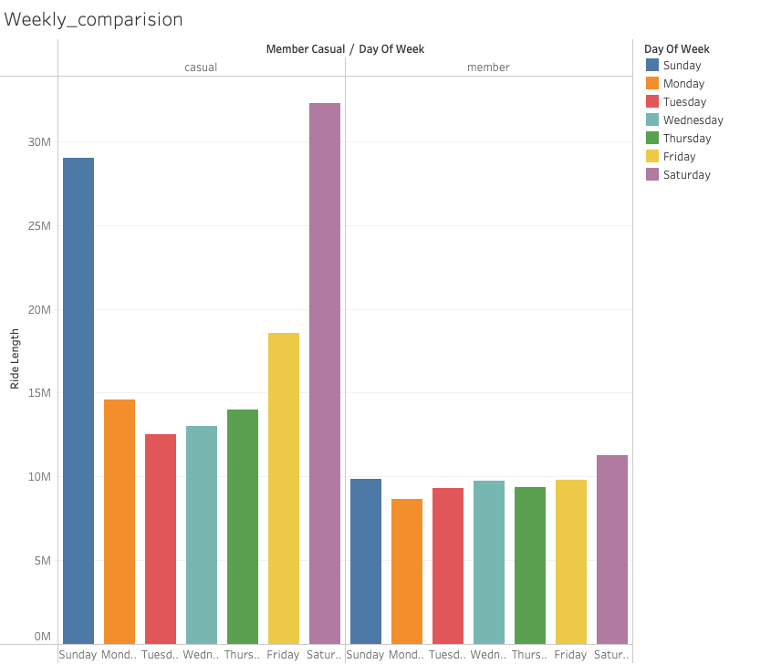
Weekly comparison
Casual riders travel most on Weekends
Casual riders use it for Vacation purpose
From Friday the graph increases till sunday and then falls during weekdays for Casual riders
Members are almost consistent throughout.

Slide 7
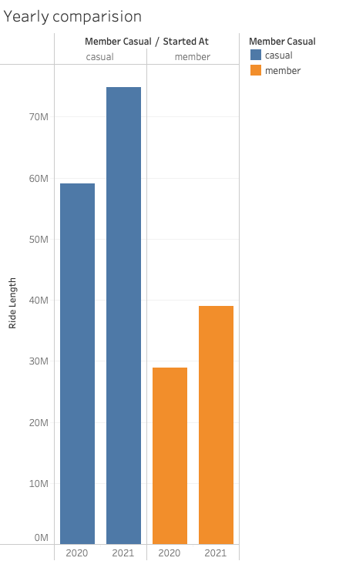
Yearly comparison
There is an increase in travel by Casual riders and Annual members in 2021
Covid might be the reason for lesser travel during 2020
And historical data is needed to find how both Casual and annual riders traveled before Covid

Slide 8
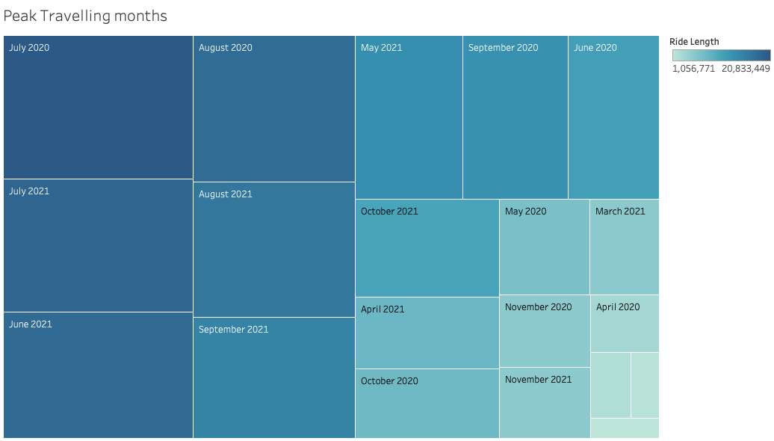
Peak Travelling Months
Peak travelling months are June, July, August and September.

Slide 9
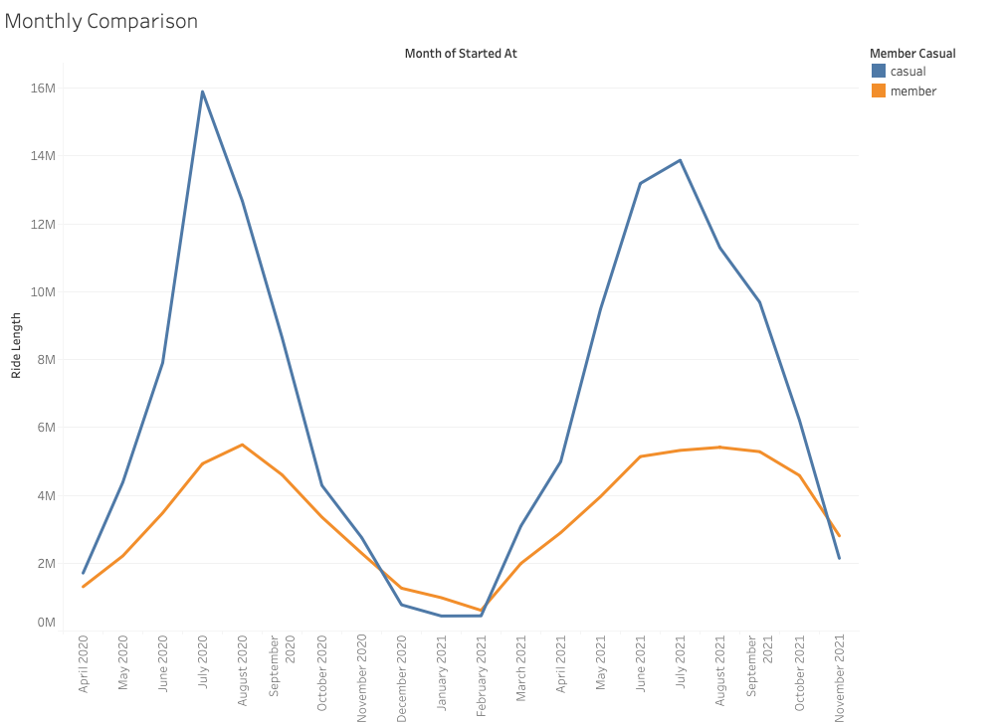
Monthly comparison
Casual riders travel most during the month of July.
They travel least during February.

Slide 10
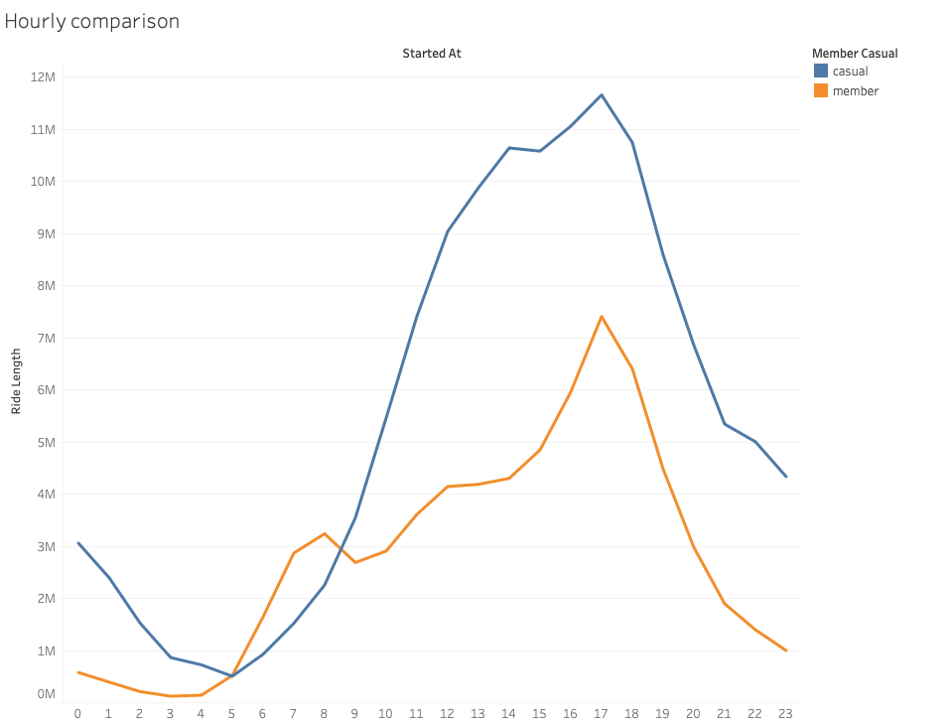
Hourly comparison
Peak travelling hour is 5:00 pm for both Casual riders and Members.
At 3:00 am Members travel the least
At 5:00 am Casual riders travel the least

Slide 11
Conclusion
Casual riders travel mostly during Weekends
Casual riders prefer Docked_bikes and Classic_bike the most
Casual riders travel mostly in the month of July
Peak travelling time for Casual riders is 5:00 pm

Slide 12
Thank you

